Slide 1
Evaluating the Potential for Wake Steering of U.S. Onshore Farms
David Bensason
08/21/2020
Notes:
Welcome.
Thank you for joining.
This will be a quick informal presentation about the work I did with Eric over the past six months.

Slide 2
Contents
Background and Motivation
Project Goal
Methods
Results
Conclusions
Conclusions
Notes:
Quick overview of what is included in the presentation.
Can simply list through them.

Slide 3
Background and Motivation
Notes:
Worked on the project for the last six months
Based on work from last summer that we started

Slide 4
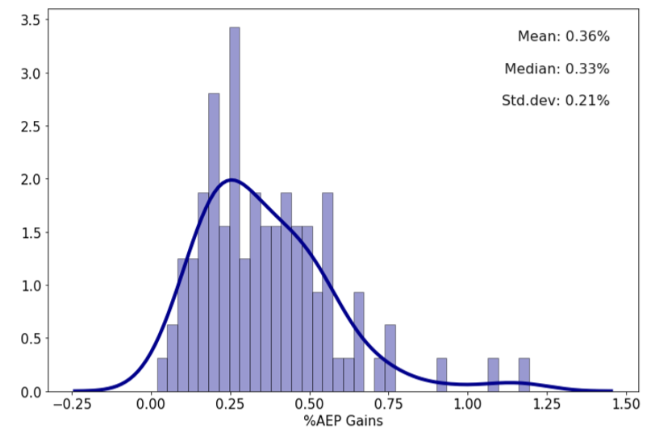
SULI 2019 Project
Distribution of AEP gains for 100 farms
Performed wake steering optimizations for 100 U.S. onshore wind farms from the U.S. Wind Turbine Database.
Used the Gaussian wake model.
Results were lower than expected.
Used existing ambient TI lookup table. Did not result in a possible range.
Farms were selected somewhat randomly. No attention to distribution of size, capacity or region.
Notes:
We worked on a project last summer using FLORIS to predict wake steering gains for existing onshore wind farms.
We can see the dist of AEP gains for a set of 100 farms. Results were lower than we have hoped for.
Partly due to the Gaussian wake model we used where now the GCH model includes features that can better predict wake characteristics on larger turbine arrays. Perfect for this project.
We also used an existing TI lookup table from Julie Lundquist paper. Did not achieve some idea of uncertainty or range.
Payed less attention to the farms selected.

Slide 5

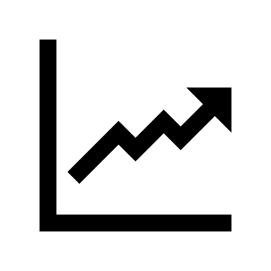
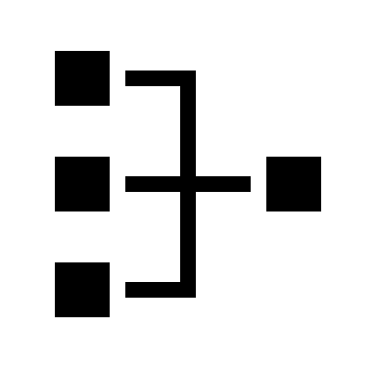
Goal
1
2
3
“Develop a method that will predict wake steering gains (AEP gains) more accurately for a representative set of windfarms and quantify the effects of variables such as relative turbine spacing, turbine specific power and wind resource on the potential of wake steering”
Method
How can we predict more accurate wake steering gains?
Trends
What kind of gains are we observing for a representative set of farms?
Effects
What are the effects of farm, turbine and wind resource characteristics on wake steering?
Notes:
Read Goal. Break up into 3 sections.

Slide 6
Methods
Notes:
What tools did we use to achioeve

Slide 7
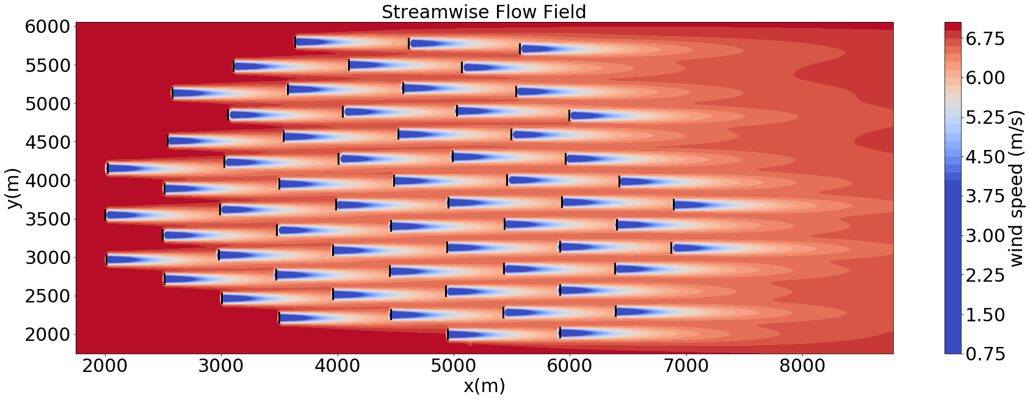
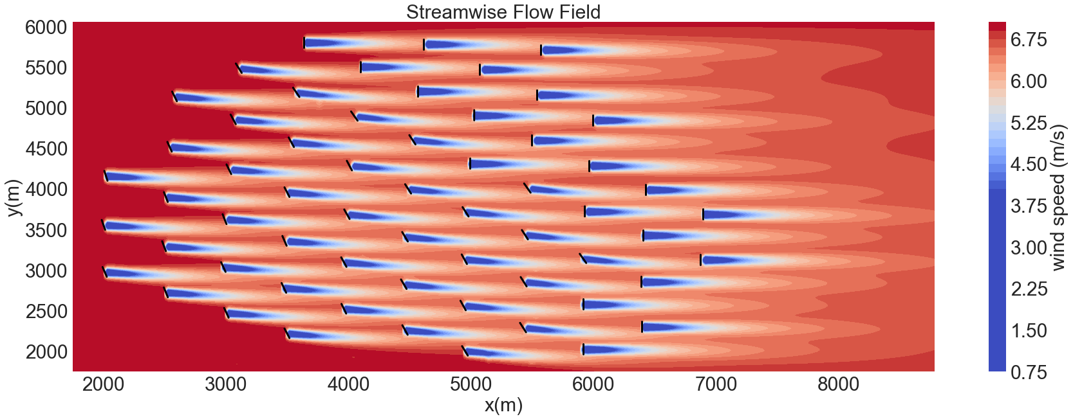
FLORIS Engineering Model for Wake Steering
FLOw Redirection and Induction in Steady State developed by NREL and the Technical University of Delft.
Control-orientated open-source modular framework.
FLORIS models wake interactions between turbines.
Can be used to:
1) Design wind farm controllers.
2) Predict performance.
3) Optimize farm layouts.
In this report, we use FLORIS tools to optimize for annual energy production (AEP) using wake steering control and calculate the AEP gains.
No Yaw
Yaw
[10]
Notes:
Most of you may already be familiar with FLORIS.
Toolset for modelling wake interactions.
We used for xxx purposes.

Slide 8
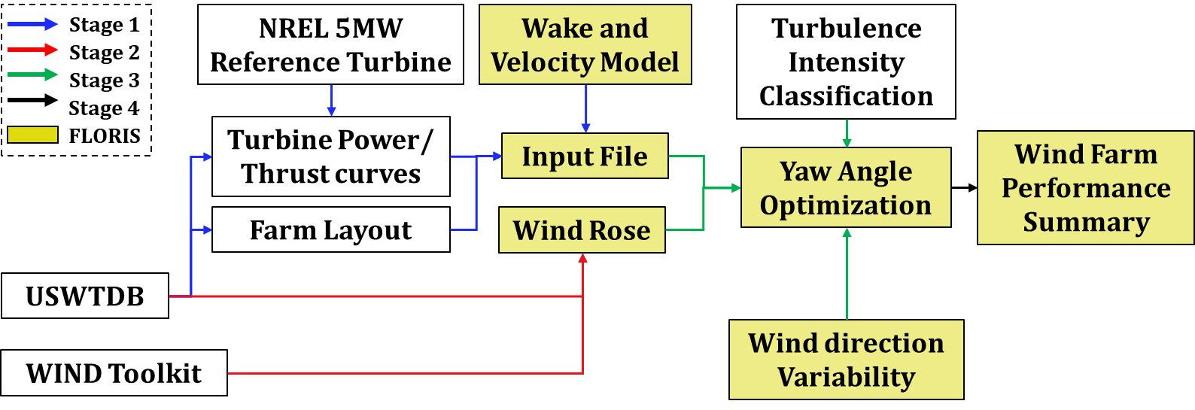
Wake Steering Optimization Flowchart
4
3
1
2
5
1
Farm Object
2
Wind Resource
3
Turbine Object
4
Atmospheric Stability
5
Wind Direction Uncertainty
Notes:
The following is a flowchart showing the methodology used when optimizing for AEP for a farm.
Won't go into detail for every step due to time and most might know the functionality of FLORIS already.
The main five can be covered to do with USWTDB, WIND Toolkit, turbine scaling and modeling atm stab. and the commercial wind farm data we used.

Slide 9
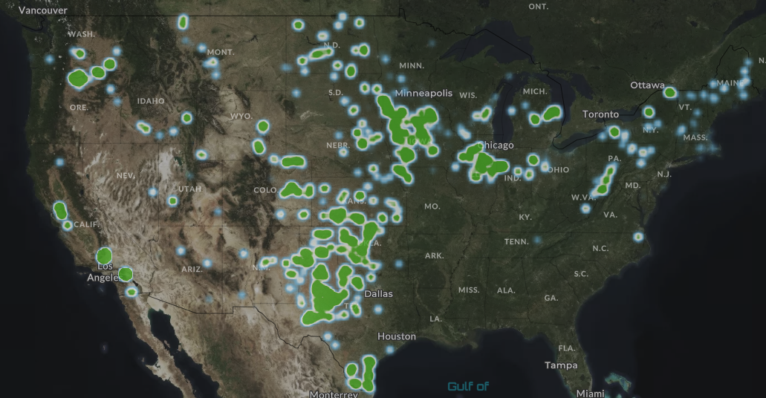
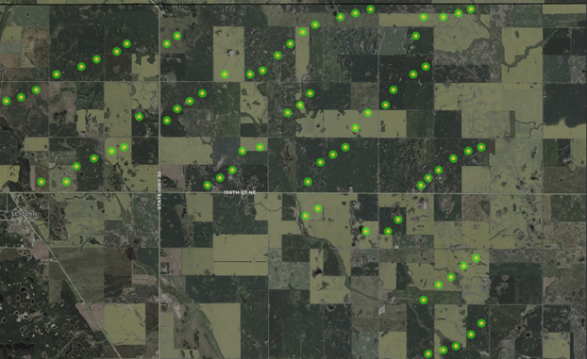
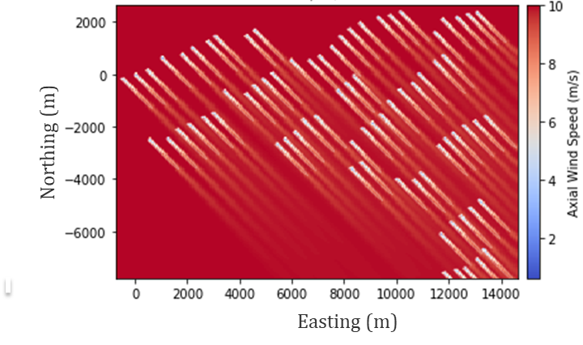
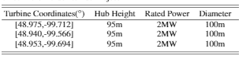
U.S. Wind Turbine Database
Farm Object
Includes over 64,500 turbines making up around 1500 farms.
Access relevant information for a given farm, outlined in the table
At 10 m/s and 315° wind direction, flow field is visualized using FLORIS
[3]
1
2
Notes:
The USWTDB includes several onshore farms with turbine level data that is updated frequently and validated.
Can draw on tabular data for a given farm and generate the farm object on Floris.

Slide 10
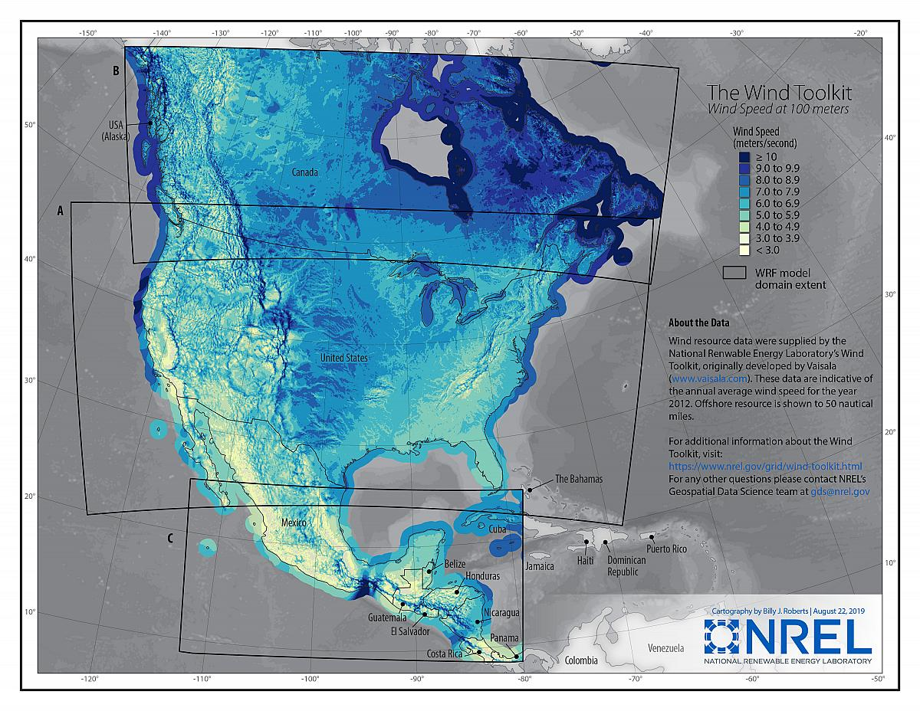
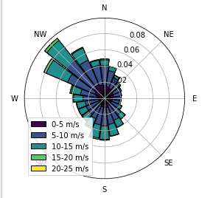
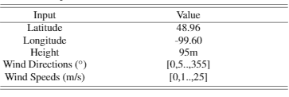
Wind Integration National Dataset (WIND) Toolkit
Wind Resource
1-hour-resolution data for a 7 year time period (2007-2013) at 2km grid spacing(126,000 sites) for the continental United States
Based on input table, FLORIS generates wind rose.
Wind rose shows hourly average frequencies of input wind speed and direction combinations.
[4]
Wind Rose
Notes:
For the given coordinates of the farm we can summarize the direction, magnitude and frequency of wind resource conditions in the form of the wind rose.
This is important for the optimization procedure and power generation.

Slide 11
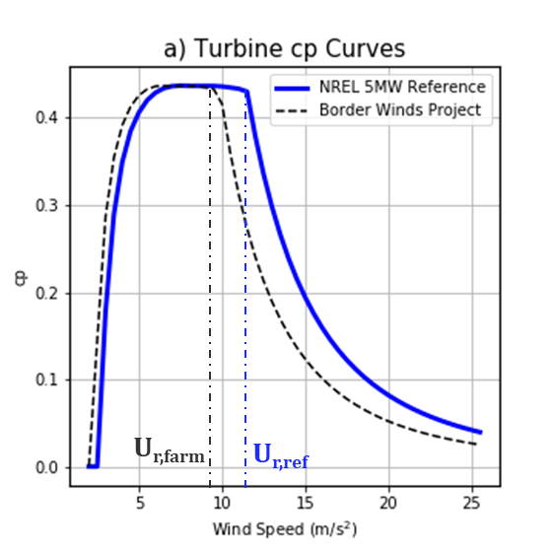
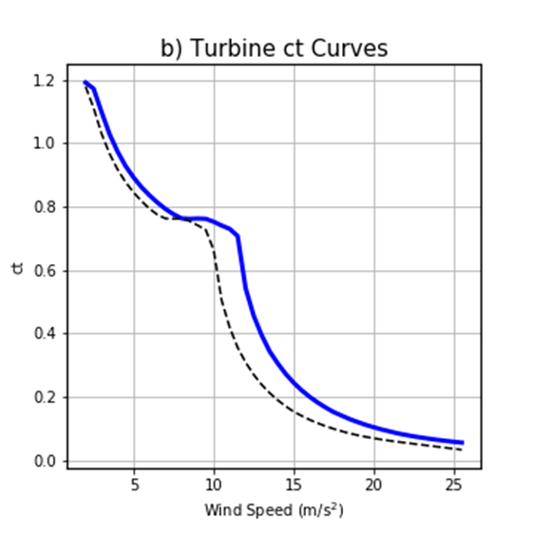
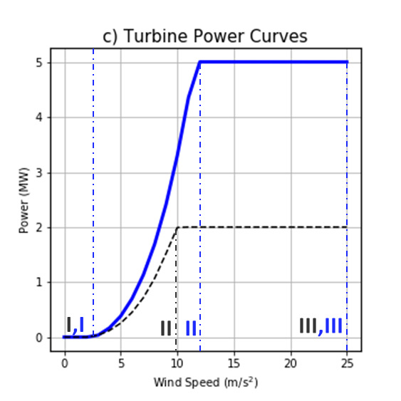

Scaling NREL 5MW Reference Turbine
Turbine Object
D=126m
C_{p} and C_{t} coefficients are interpolated based on rated wind speed of turbine.
Assumes same C_{p} at rated wind speed.
D=100m
5MW
Scaling
2MW
NREL 5MW Reference Turbine
Border Winds Project Turbine
Notes:
FLORIS uses power and thrust coefficients to define turbine.
We don’t have this data for every turbine in the USWTDB since its proprietary.
We use a method of scaling the available data from a 5MW reference turbine shown here.
We assume a constant rated power coefficient to find the rated wind speed.

Slide 12
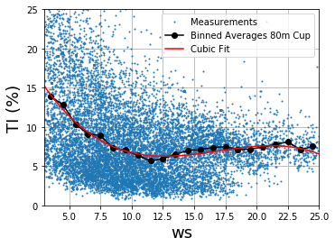
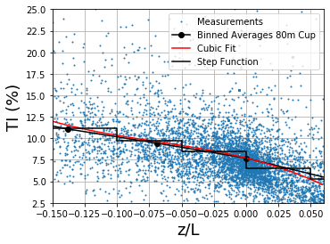
How did we model ambient TI?
Atmospheric Stability
Convective
Stable
10-min resolution data collected using lidar from active NREL field experiment on commercial wind farm.
z is the height measured above the ground (10m), yielding a dimensionless parameter.
U.S. farm simulations were run at constant ambient TI of 6%, 8% and 10%. Range of values will quantify some uncertainty.
Ambient TI models tested on parametric wind farm.
Notes:
Modeling atmospheric stability within engineering wake models is still an ongoing area of research.
The wind toolkit does not include any data that explicitly defines atmospheric stability.
Obukov length and wind speeds are a couple of the methods used in literature to model ambient TI. TI is a heavy indicator if stability within FLORIS.
Introduce the two methods we used with general trend. We use step function for z/L method and interpolation for ws method.
Mention we are looking at set three TI values and discussed why 8% was looked into.
The TI values are scaled with wake loss scaling to match 8% case more closely.

Slide 13
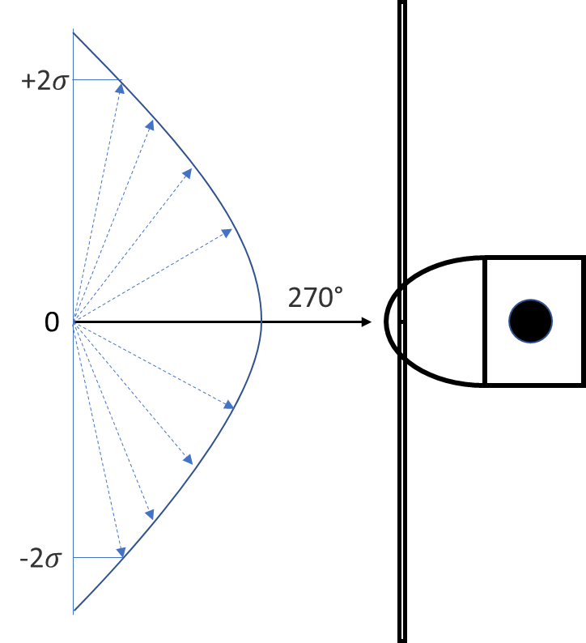
Wind Direction Variability
Standard model assumes yaw misalignment falls on optimized yaw with no uncertainty or lag.
In realistic deployment, controller will not be able to track changes in wind direction perfectly, resulting in a discrepancy between optimized yaw and wind direction.
Current method normally distributed zero mean probability density function (PDF).
Notes:
FLORIS simulation assumes no lag or uncertainty when setting to optimized yaw angles. – Not realistic.
Recently a feature that Eric worked on accounts for wind direction variability has been added to FLORIS using a normally distributed PDF function.
We will also investigate the effects of this on the results.

Slide 14
U.S. Onshore Wind Farm Results

Slide 15
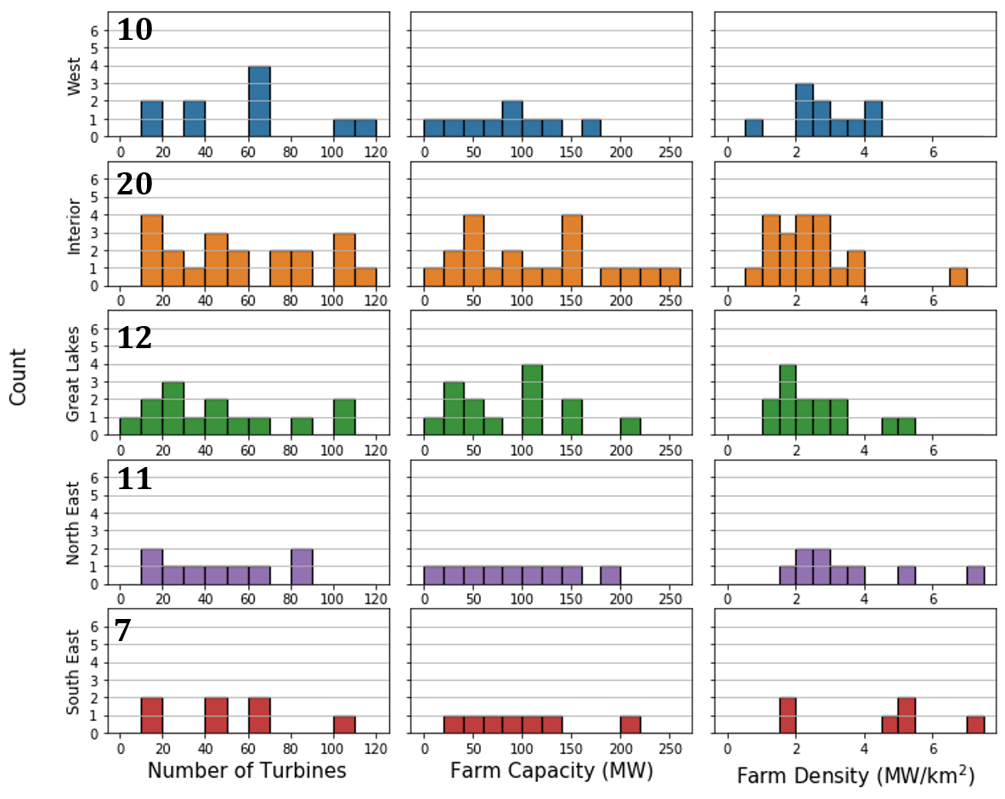
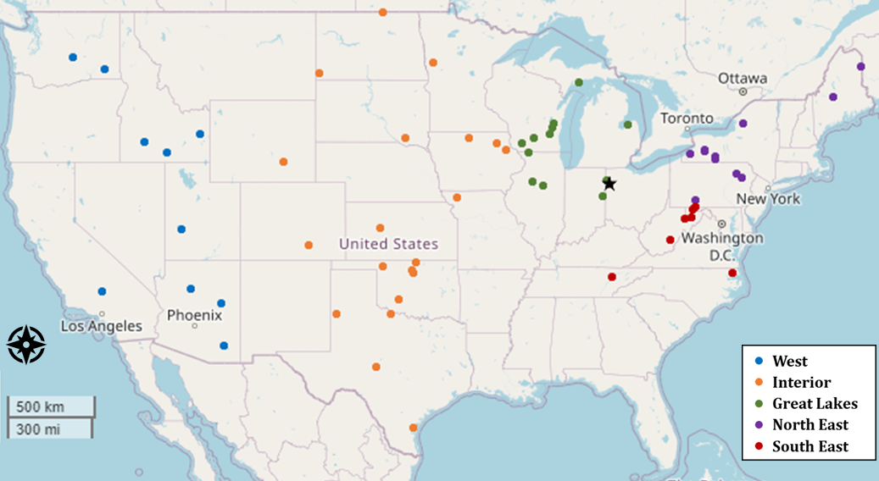
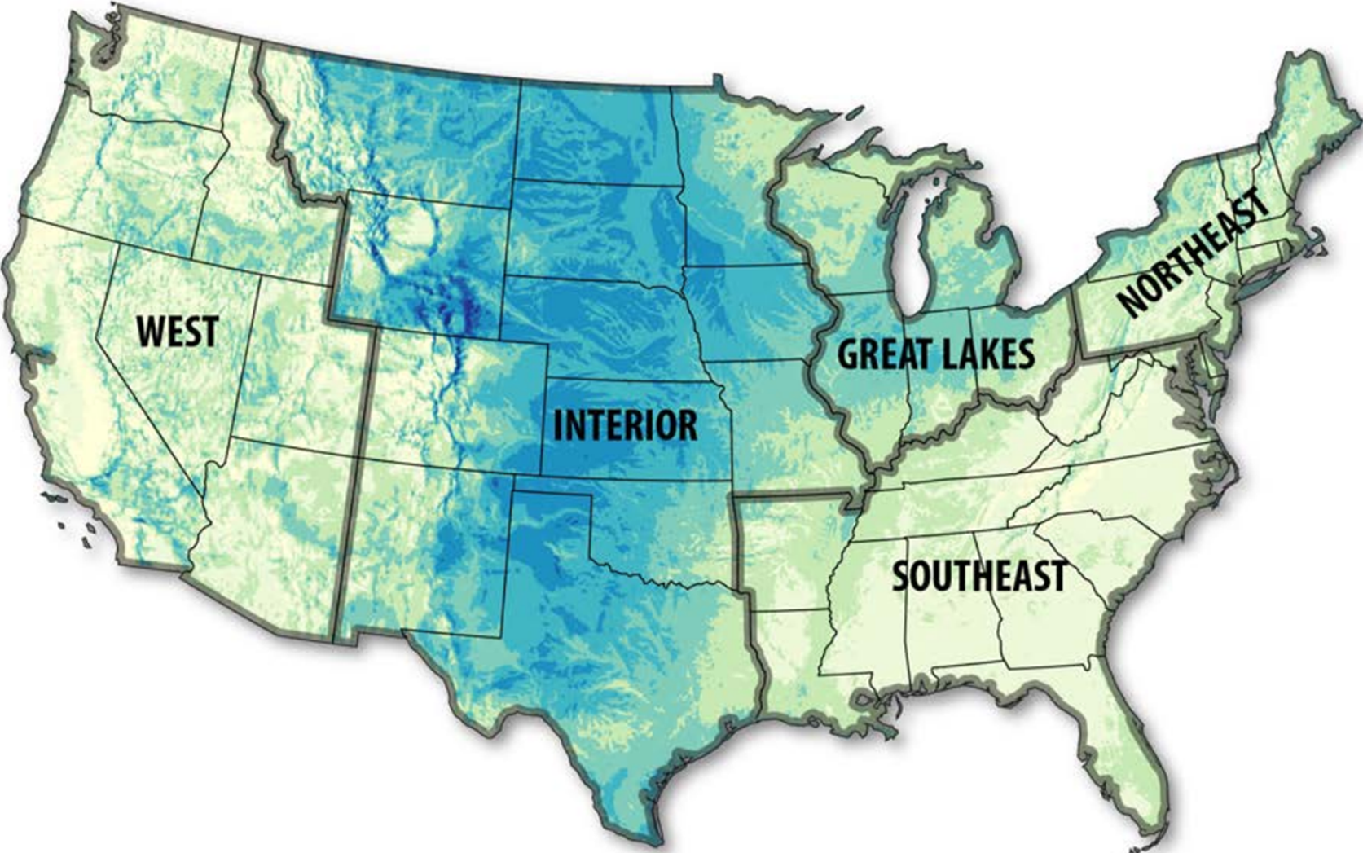
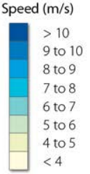
Subset of U.S. Onshore Farms
Set of 60 farms chosen from the USWTDB.
Relatively even spread of farm size, capacity and farm density.
Number of farms chosen in each region is consistent with the wind resource and installed capacity.
[5]
Notes:
Due to computational and time constraints we chose a representative set of 60 farms from the USWTDB
Ensuring a good spread between size, capacity and density.
Number of farms in each region is representative of the wind resource and installed capacity

Slide 16
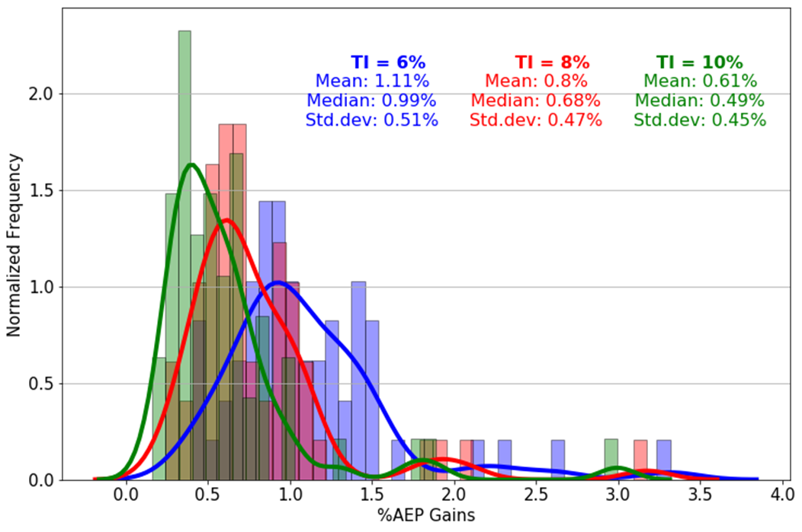
Ambient TI Results: % AEP Gains
Average AEP Gain distribution across 60 farms
Range of average AEP gains suggest high potential for wake steering.
Increase in AEP gain is expected with lower TI due to larger effects of wake losses.
Increase in standard deviation with decreasing TI. Farms that do not benefit with a higher TI may only improve marginally at high average turbine spacing.
Notes:
FLROIS uses ambient TI input as a metric for atmospheric stability and has a large effect on wake behavior in the flow field.
As expected, lower TI have higher AEP gain as more wake losses are apparent.
Running each farm at three gives us a comprehensive range of possible AEP gains.

Slide 17
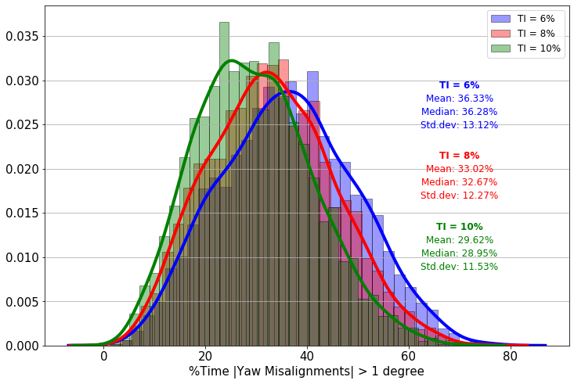
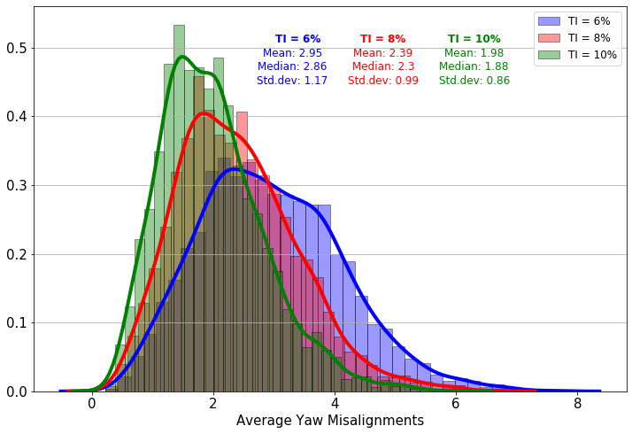
Ambient TI Results: Yaw Misalignment
% time turbines spend yawing increases with decreasing TI on average.
The standard deviation and shape of the kernel density curves do not vary much with difference in TI.
Although the time spent yawing is relatively high, the average yaw misalignments are minor.
Similar shape of average yaw curve and AEP curve suggests correlation.
Notes:
Next we can look at the turbine level behavior.
Turbine spend a large %time yawing above 1 degree.
Increases with more Ti since wakes are more relevant.
Although time spent yawing is high, the average yaw misalignments are quite low. We can see an increase in average with TI since more yaw required.
Similar shape suggests a correlation between AEP and average yaw as well.
Wake steering isn’t as effective at high TI since energy gain for downstream turbine might not be worth it.
Might be worth looking at dist of yaw (without average).

Slide 18
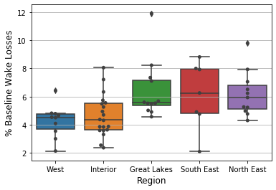
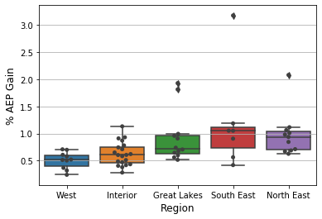
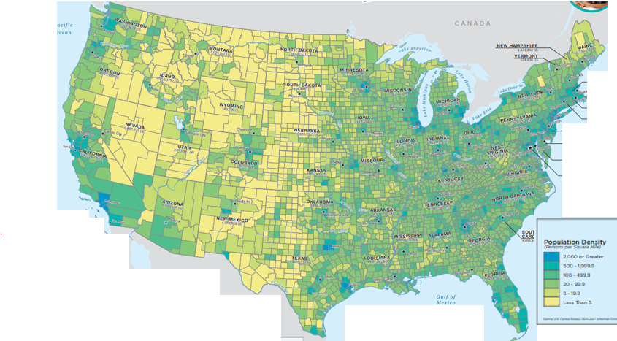
Trends by Region
West and Interior have lower baseline wake losses on average than Great Lakes, South East and North East.
Higher baseline wake losses in latter three regions due to higher population density (more land area constrains and denser farms).
AEP is between 0.5% and 1.5% and reflective of baseline wake losses.
2020 Population Density Map
[6]
Notes:
Looking at the AEP gains as a function of region shows greater potential for latter three regions due to higher wake losses.
Can be inefered from higher population density that there is more infrastructure and houses and hence for land area constraints -→ denser farms.

Slide 19
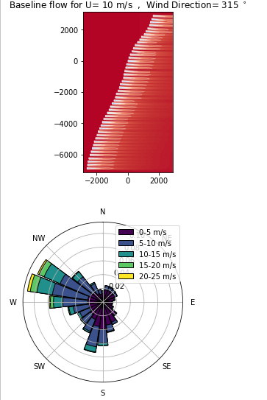
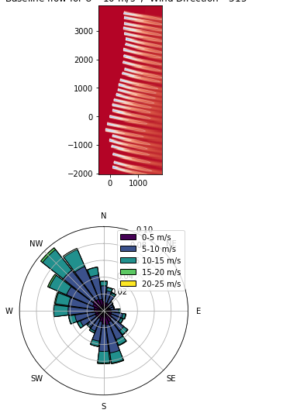
Outlier Case Studies
New Creek Wind, South East
Mars Hill, North East
Northing (m)
Northing (m)
a
b
Easting (m)
AEP Gain = 3.17%
Easting (m)
AEP Gain = 2.08%
Both farms have linear turbine geometries at a certain wind direction.
Although the wind directions at which we would expect baseline wake losses to be high aren’t the most frequent, the cases where they do occur result in substantial wake losses.
Directional farms also perform well for wake steering due to secondary steering.
Notes:
Taking a look at two of the outlier cases.
We see very direction wind roses and farms.
Although they do not overlap, the wake losses associated are still severe.
These directional farms show high potential for wake steering and secondary steering due to high wake losses

Slide 20
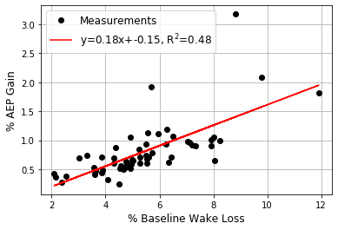
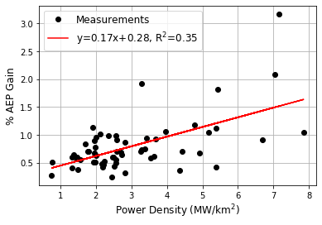
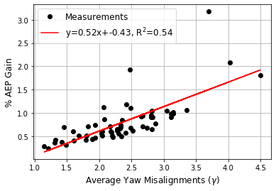
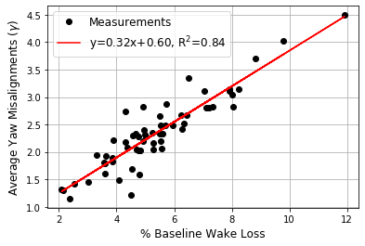
Other Trends
Baseline wake loss does not imply good wake steering potential nor does the power density.
Strong dependence of average yaw misalignment on wake losses.
Notes:
Finally we can take a look at some of the macro trends.
In general we can see a correlation between AEP gain and baseline wake losses, farm power density and average yaw misalignment.
Not that strong, suggesting other factors such as orientation etc.

Slide 21
Parametric Study Results
Notes:
So now to take look at the parametric study method and results.

Slide 22
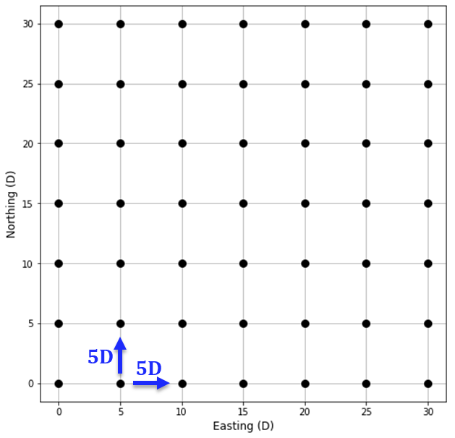
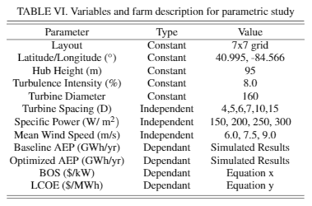
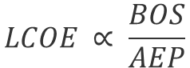
Parametric Study Method
LCOE = Levelized Cost of Energy
BOS = Balance of Station Cost
Combinatorial study of 72 cases.
Effects on wake steering performance (AEP gain)
Effect on BOS and LCOE.
$$LCOE ∝ \frac{BOS}{AEP}$$
Notes:
Using a constant farm layout grid orientation of 7x7s
Performed a combinatorial study changing the independent variables that encompass wind, turbine and farm resources.
Looked at the effects on wake steering performance via AEP gains and baseline wake losses
BUT ALSO
On the effects for BOS and LCOE.
BOS = infrastructure, assembly and installation etc.
LCOE is baslically the cost of producting the enerfy over the amount of energy. Can be used to compare to different types of resoreuces.

Slide 23
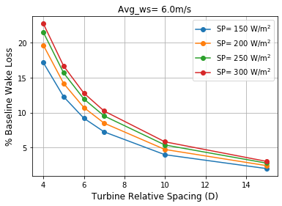
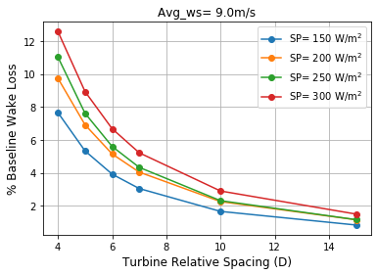
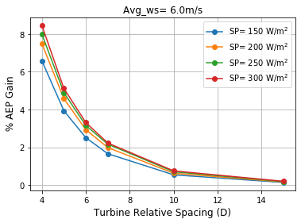
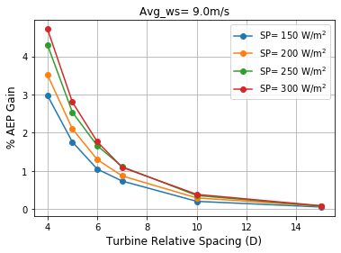
Trends in Wake Steering Performance
Increase in Wind Speed
Decrease in baseline wake losses with increasing average wind speed due to the decrease in thrust coefficients
Higher specific power machines leads to increased baseline wake losses due to larger region II in power curve.
Increased relative spacing leads to decrease in wake losses as they have more time to dissipate.
Notes:
List the main trends here.
Can read these out.

Slide 24
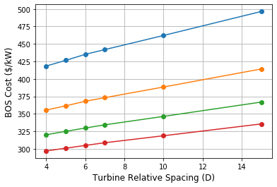
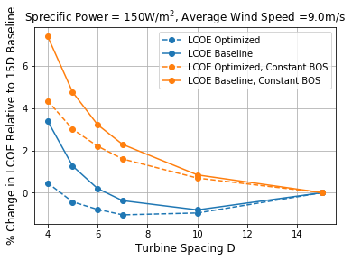
Trends in BOS and LCOE
Accounting for BOS lowers the LCOE since it is normalized at the 15D case (maximum possible).
BOS is more sensitive to the turbine specific power (SP) than the relative spacing.
At this low SP and high average wind speed (resulting in the lowest AEP gain), we see a notable shift in the inflection point to a lower relative spacing when using wake steering.
Minimum LCOE is optimum. Inflection point where the benefits of higher AEP due to large spacing no longer outweigh the related high BOS costs.
Notes:
Relative effect of SP on the BOS is higher than the spacing.
Looking at a single case with turbine specific power and high average wind speed. → Leads to lowest baseline wake losses
Without accounting for BOS we see both curves are asymptotical where eventually no more gains in LCOE due to dispreance of wake losses.
Accounting for BOS we see an inflection point. (read third)
Shifts to lower possible LCOE at denser farm.

Slide 25
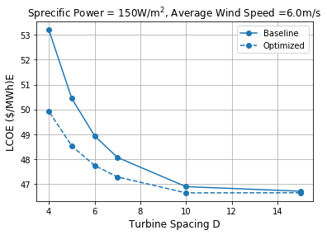
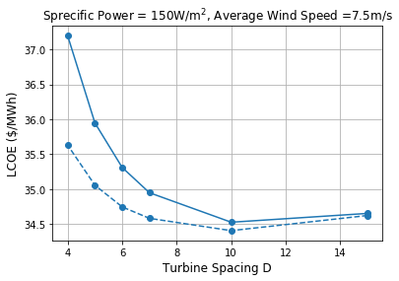
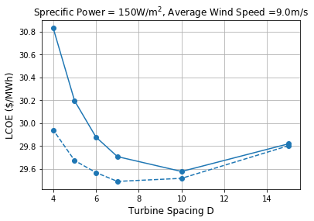
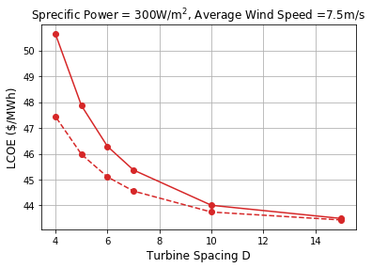
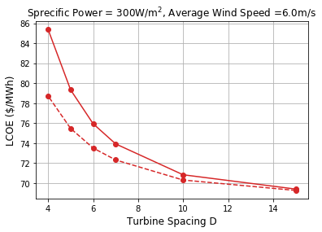
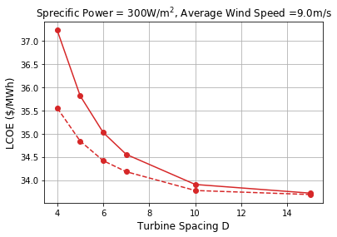
Trends in LCOE
The optimum LCOE was not observed for all cases but was getting close. Different for each due to different AEP behavior at wind speeds and specific powers.
Both the increase in SP and wind speed decrease the LCOE due to higher AEP performance.
Notes:
Taking a broader look at the effects of wind speed and SP.
We see lower avg wind speed takes away the optimum and so does the higher SP. Since we experience higher AEP.
We can expect to see the inflection at a much higher spacing.

Slide 26


Case Study
For a constant LCOE of 38$/MWh:
Baseline Density = 4.4 MW/km²
Optimized Density = 7.4 MW/km²
% Change = 68.2%
For a constant average wind speed, increase in SP leads to a decrease in the %change in LCOE. Consistent with the results from before (increase in AEP gain).
For a constant LCOE of 38$/MWh, we see a 68.2% increase in power density when employing wake steering.
Notes:
Finally looking at a case study
Assuming a constant power density we see a decreasing relative effect on LCOE when using wake steering. As we saw previously.
However, at constant target LCOE we can see an increase in power density.

Slide 27


Wind Direction Variability and TI Models
The AEP gain behavior is consistent with previous results across all methods.
Wind direction variability has a larger negative relative effect on larger turbine spacings. Wakes have more time to deflect and hence results in larger changes in wake position downstream.
Both TI models outperform the 8% case as the benefits of lower TI outweigh the drawbacks of TI higher than 8%.
Both TI models have increasing relative effects as the spacing increases.
Notes:
Finally we look at the effects of the two models for TI and wd uncertainty.
Wd has negative impact while other have positive. Due to trade-off of the lower TI values experienced. The general results oul increase and decreae the baseline results we got at varying degrees. Still an active area of research.
We cannot validate either TI model but could maybe compare to ongoing field experiment data.

Slide 28
Conclusions
Notes:
Revised December 18, 2019 – Elizabeth

Slide 29
Conclusions
For a representative set of 60 farms, average AEP gains were 1.11%, 0.8% and 0.61% for ambient TI of 6%, 8% and 10% respectively.
-> Suggests a high potential for wake steering and high sensitivity of AEP gain to TI.
-> High sensitivity also apparent when using different ambient TI models.
-> Future research could focus on improving models of site-specific TI distributions at wind farms and incorporating stability within engineering wake models.
Notes:
Heavy dependence of AEP on TI makes modeling this in engineering wake models important for the future. -> introduced two methods which may be somewhat site specific -> should test
In general high average results with range of possible values.

Slide 30
Conclusions
Wind direction variability introduces layer of uncertainty with high relative impacts on AEP gains at larger turbine spacings.
-> Future research can focus on developing more advanced wake steering controllers with improved wind direction tracking capabilities.
-> Wind direction variability can also be used in simulations for a subset of the simulated farms of interest.
Notes:
Wind direction variability also has large effects on results and will cause them to decerase.
Would be interesting to see four cases: 1) No wd unc constant TI, 2) No wd unc with TI models 3) Wd unc with no Ti, 4) With wd unc and Ti model
Future research into wd unc modeling will help.

Slide 31
Conclusions
Average yaw misalignments were low with high percentage time turbines spent yawing above 1°.
-> High percentage times may be concerning to farm owners/operators.
-> Future research should look at wake steering potential captured when setting constraints on the amount of time turbines can spend yawing.
-> Alternatively, could look at the limiting the number of turbines that can be yawed in the farm. This introduces another optimization problem to identify which turbines are the most critical when maximizing AEP.
Notes:
We saw a large percentage time spent by turbines yawing. This can be filtered even more by using a higher cut-off.
Effect of setting a limit on time or number of turbine yawing.

Slide 32
Conclusions
Not all farms show potential for wake steering, with a range of AEP gains. Top 10% of simulated farms have average AEP gain of 1.89%.
Highest performing farms included long rows of near linear turbine orientations.
Great Lakes, North East and South East showed the highest potential for wake steering due to higher baseline wake losses from increased siting constraints.
-> Future research could focus on developing a method that identifies favorable farm orientations for wake steering and how the corresponding wind resource compliments them without having to perform yaw optimizations.
-> With increasing siting constraints for future projects, the potential for wake steering will increase. Close turbine spacings and low wind speeds show best wake steering potential as ween in the parametric study.
Notes:
Not all the farms show potential. This method can be used to identify and validate farms of interest.
More dense regions so more potential and as constraints increase they will as well.

Slide 33
Conclusions
Parametric study showed highest wake steering potential for low turbine spacing, low average wind speed and high turbine specific power.
In general, lower LCOE was achieved with higher turbine spacings, higher average wind speeds and lower specific powers.
Combination of low turbine specific power and high average wind speed resulted in a visible inflection point for LCOE. Inflection point shifted from 10D to 7D spacing for baseline and optimized case, respectively.
For a constant average wind speed, turbine specific power and target LCOE value of 38 $/MWh, wake steering enabled a 68% increase in farm power density.

Slide 34
Thank you! Q&A

Slide 35
References
[1] https://www.nrel.gov/flatirons-campus/
[2] Simley, Eric. Opportunities for Offshore Wind Farm Control.
[3] D. J. R. J. K. L. G. C. Hoen, B.D. and H. Hunt, “United states wind turbine database (ver. 3.1, july 2020),” (2018).
[4] A. C. C.Draxl, B.-M. Hodge and J. McCaa, “Overview and meteorologi-cal validation of the wind integration national dataset toolkit,” Tech. Rep.NREL/TP-5000-61740 (National Renewable Energy Laboratory, 2015).
[5] R.Wiser and M.Bolinger, “2018 wind technologies market report,” Tech.Rep. DOE/GO-102019-5191 (U.S. Department Of Energy, Office of En-ergy Efficiency Renewable Energy, 2019).
[6] https://www.census.gov/programs-surveys/sis/2020census/2020-resources/2020-maps/understanding-us-pop-hs.html
[7] https://thesource.nrel.gov/flatirons-251-renovation/
[8] J. King, P. Fleming, R. King, L. A. Martínez-Tossas, C. J. Bay, R. Mudafort,and E. Simley, “Controls-oriented model for secondary effects of wake steering,” Wind Energy Science Discussions 2020, 1–22 (2020).
[9] Stehly, Tyler. 2018 Cost of Wind Energy Review.
[10] Fleming, Paul A., et al. "Wind plant system engineering through optimization of layout and yaw control." Wind Energy, 19.2 (2016): 329-344.

Slide 36
Extra Slides for Clarification
Appendix

Slide 37



Wind Direction Variability
+2$σ$
P_{Unc} = turbine power with wind direction uncertainty.
P_{FLORIS} = power calculated by FLORIS without uncertainty.
∆_{φi} = deviation from wind direction for a perfectly normal case
ρ(∆_{φ})= normal distribution representing uncertainty in the wind direction
σ = standard deviation of the wind direction, in this case set to 4.95◦
270°
0
-2$σ$

Slide 38


Case Study
Regions 1 and 2 show large potential for wake steering.
Region 2 gains will be weighted more heavily.
Notes:
Taking the weighted averages of combination yields the overall annual performance of the farm. We can see the normalizes energy production which is consistent with wind rose .
At region 1 and 2 we see low farm efficiency due to high level of baseline wake losses shown in the figure to the right.
Although there is large wake steering potential here as seen by the peaks in the gain, we wont necessarily get the full extent of the benefits for region 1 since the power production (and wind direction) is so low.
Hence, high baseline wake losses at a certain wind direction aren’t enough for wake steering potential. Rather, a combination of the wind rose and farm layout.

Slide 39





Turbulence Intensity
Turbulence intensity is ratio of the standard deviation of fluctuation wind velocity to the average velocity.
$$TI=\frac{σ_{U}}{U_{mean}}$$
TI = 12%
TI = 6%
High TI = Strongly convective = Faster wake dissipation = Reduced wake losses
Low TI = Strongly stable = Slower wake dissipation = Increased wake losses
Notes:
Turbulence intensity coefficient of wind speed at a given direction.
It is one of the main parameters when predicting atmospheric stability and has large implications on the wake behavior of turbines.
FLORIS used wind shear and veer to model atmospheric stability, but TI is the driving method.
Bottom two plots show the effects of ambient TI for a basic grid farm layout (described in more detail later).
Rate of wake loss increases a bit with lower TI. Why the rate is so clear in the AEP gain. Has a more than linear effect.
We see that tighter spacing benefits much more (more wake loss) but rate is also slower cause even more dissipated wakes do better at tighter spacing.

Slide 40
Improvements to the Wake Model
Gaussian
Curl
Pros:
Fast!
Accounts for overlap in wakes.
Main model for recent NWTC publications.
Cons:
Underpredicts gains of downstream turbines.
Does not account for effects of counter rotating vortices (deflects and deforms downstream wakes.)
Pros:
Accounts for the counter rotating vortices.
Able to predict the effects on downstream wake shapes.
Accounts for secondary steering and wake added recovery.
Cons:
More complex than the Gaussian.
Takes close to 1000x longer to run.
Gauss-Curl Hybrid (GCH)
Includes all all the main features of the Gaussian model and the speed!
Accounts for secondary steering and multi-turbine effects.
Notes:
Wake added recovery: Wake recovers more when turbine is being yawed due to large-scale entrainment of flow in wind farm domain.
Secondary Steering: These dissipated wakes impact the wakes of the downstream turbine as well ---effect deformation and deflection of the downstream wakes.
Both are important for large scale arrays and farms.

Slide 41


Turbine Scaling Steps
Step 1: Rearrange power equation to solve for rated wind speed using turbine rated power and C_{p} rated from reference turbine.
Step 2: Create a list of Cp and Ct versus normalized wind speed for the reference turbine. Rated wind speed of reference is 11.4 m/s.
Step 3: For each wind speed divide by turbine rated velocity from step 1 and interpolate for C_{p} and C_{t} from list in step 2.
Turbine Power Equation
Rearranged Equation

Slide 42






Case Study Equations from Optimization Steps
Find the total power production of the turbines at each combination.
Multiply by the frequency of that combination and sum to find the weighted average power production of the farm.
Multiply by the 8760/10⁹ to change units to GW/yr
Wake loss is the change between the baseline and no-wake case or optimized and no-wake case.
Wake loss is the change between the baseline and no wake case.
Reduction in wake loss is the change in wake loss between the baseline and optimized case.

Slide 43

More Information of TI modeling
Where k is the von Karman’s constant. Characterizes the dimensionless wind shear for statically neutral conditions.
u* is the friction velocity (measure of surface stress).
Qv0 is the kinematic virtual temperature flux at surface, and Tv is the virtual temperature (temperature that dry dry air would have if its pressure and density were equal to those of a given sample of moist air.)
g is gravitational acceleration.
Steps to scaling the TI models:
For z/L method:
Find the wind speed, wind direction and TI combinations based on the original model.
Multiply all TI column by frequency and find weighted average.
Scale TI column so that the average is 8%.
For the wind speed method:
Weigh the interpolate TI values by the gains at each wind speed.
Find the average of the weighted TI and scale these for an average of 8% TI.

Slide 44


Second Order Models using JMP for AEP

Slide 45


Second Order Models using JMP for LCOE

Slide 46



Additional Parametric Graphs
AEP baseline and optimized curves

Slide 47


More information on the wake model
[8]
At both low and high TI the GCH has predictions closer to the SOWFA simulations (Simulator for Wind Farm Applications).

Slide 48

Wind Direction Variability and TI models
Both TI models perform consistently better across all wind direction. Some cases are below 8% case but minimal and at high efficiencies.
Wind direction variability under performs the 8% case at most wind direction. In cases where it over performs the efficiency is already high, hence the low gains.

Slide 49



More Information on the LCOE Variables
$$CapEx=TCC+BOS$$
Reference Onshore Farm [9]
$$LCOE= \frac{FCR\left(BOS+TCC\right)+O\&M}{AEP}$$
LCOE = Levelized Cost of Energy
FCR = fixed charge rate
BOS = Balance of Station Cost
TCC = Turbine Capital Cost
O&M = Operation and Maintenance Cost
AEP = Annual Energy Production

Slide 50


Optimization Procedure
At each wind speed and wind direction combination, the optimized yaw angles of the turbines in the farm are found that maximize the farm wide AEP.
Upstream turbines have high magnitudes of yaw misalignments resulting in negative power gain.
Downstream turbines have less yaw misalignment and increase power production due to deflected wakes. Minor yaw misalignments could be secondary steering.
Notes:
During the optimization, the package will minimize the negative farm power production (hence maximizing it).
For each wind speed and wind direction combination FLORIS will mind the optimized yaw angle and corresponding yaw angles.
For a set combination of 240 degrees and 10m/s we can see the results. Turbine arrays I and II show the effects of wake steering well and might even show the effects of secondary steering a bit.

Slide 51


Background and Motivation
[2]
Turbine (bird’s-eye)
Downstream
Upstream
Main challenges faced by operators are wake losses and increased turbine degradation.
Wakes are regions of depleted wind speed and turbulent flow generated by the extraction of energy by turbine blades.
Wakes can reduce power capture of downstream turbines by up to 30% in some cases.
Wake steering is method in which upstream turbine nacelles are misaligned with wind direction (yaw), effectively deflecting their wakes away from downstream turbines. Objective it to maximize annual energy production (AEP).
Notes:
Main challenges read-→ say we focus on wake losses here
Define wakes → use video
Wakes reduce power capture.(Show upstream and downstream turbine)
OBJECTIVE OF THE WAKE STEERING CONTROL STRATEGY IS TO MAXIMIZE AEP (Annual Energy production).
Mention wind energy is growing in the US.

